Slide 1
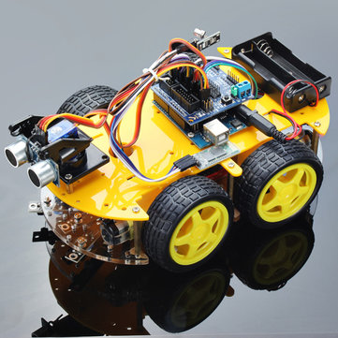
Robot Car
Exodus Ramsay
October 25 2016

Slide 2
Motivation
To create a self designed project with the knowledge I gained in the three years in this program.
Learn more how to use and built a robot car
Learn about the process of a big scale project(design , ordering parts and PCB and etc.)

Slide 3
Outline
Introduction
Block diagram
Specifications
Project schematic
PCB layout
Bill of Materials
Milestones
Improvements/Early errors

Slide 4
Introduction
My project is a 4 wheel chassis robot car
The 2 feature are (line following and object detection)
Wi-Fi control
Necleo board is the microcontroller for my project
Gui for direction controls

Slide 5
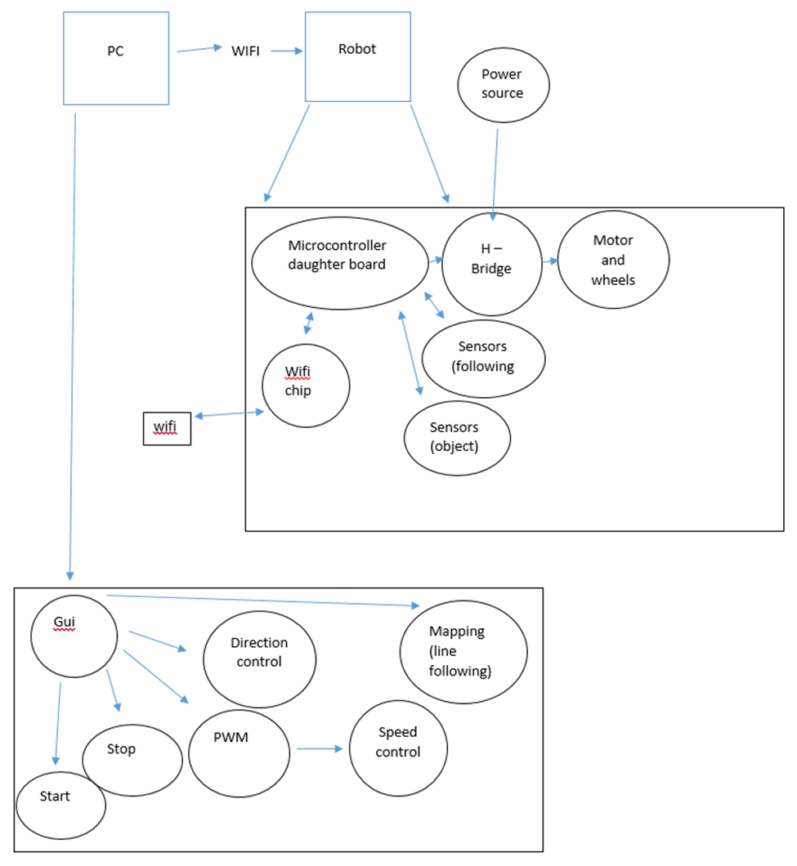
Block diagram

Slide 6
Specifications
SN754410 IC is used for the h-bridge circuit
Mini d1 Wemos Wi-Fi Chip
TRCT5000 IR sensors
SR04 Object senor
Necleo FR411RE is
Power source Two 9V battery that are in parallel
This Gui is used to control the Robot car

Slide 7
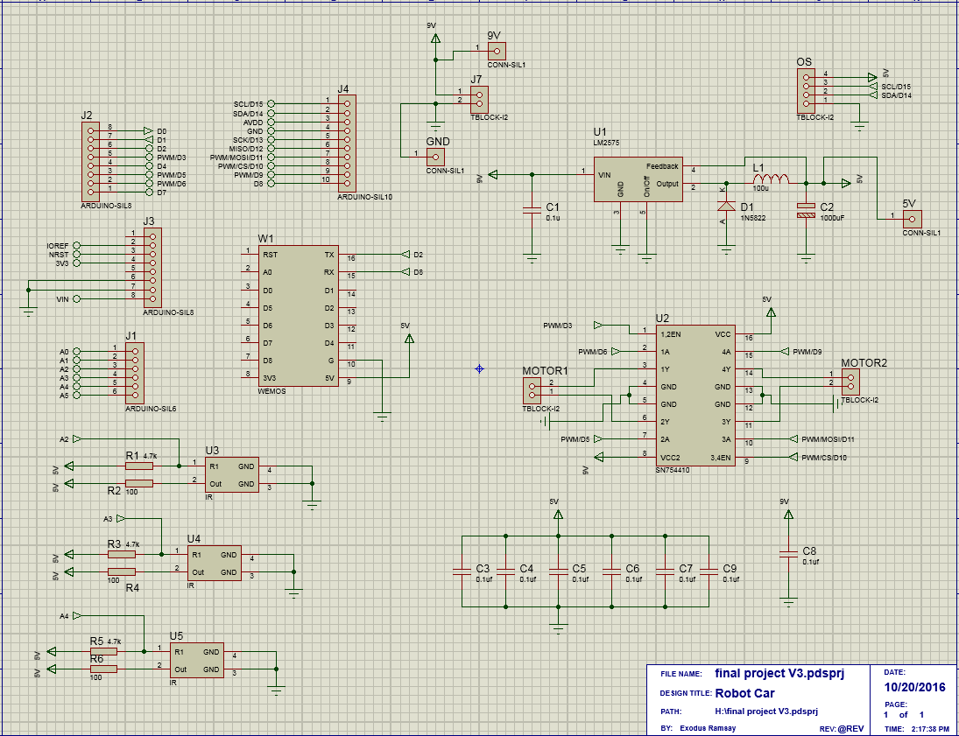
Project schematic

Slide 8
Project schematic
SN754410 IC dual motor divers IC it has 2 h-bridge in one IC that will be used to drive my motors
Step-down buck regulator from 9V to 5V at 3A
Headers are used to connect all of my components that are not directly to my pcb like IR sensors and wifi chip
Filtering capacitor’s, get rid of ripple voltage
Test points

Slide 9
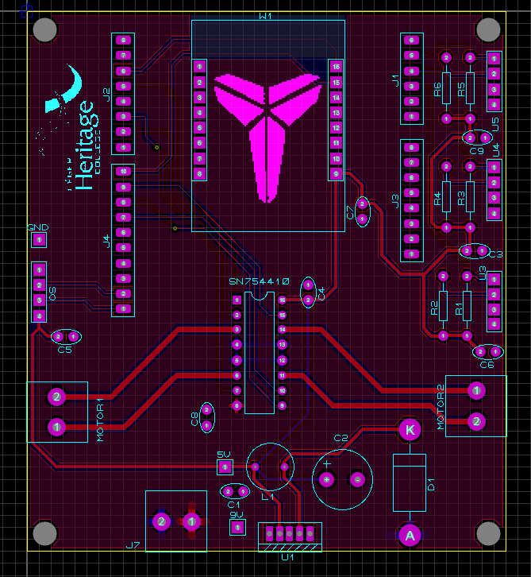
PCB layout
5cm x 8cm
Larger routes for high current protection

Slide 10
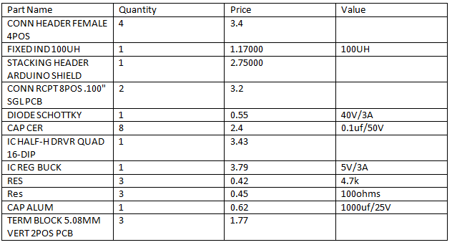
Bill of Materials
Total cost for parts
33.89

Slide 11
Milestones
Activity | Week
Brainstorming | Week 1
Initial Schematic | Week 3
PCB Layout | Week 6
Order Parts | Week 7
Receive PCB , populate PCB & Test PCB | Week 12
Hardware Testing | Week14

Slide 12
Improvements/Early Errors
I would have put in a IR remote control feature
Some of my connections was connected correctly
PCB need to be resized to be 5 by 10

